Slide 1
R
Bayesian

Slide 2
Bayesian statistics, named for Thomas Bayes (1701–1761), is a theory in the field of statistics in which the
evidence about the true state of the world is
expressed in terms of degrees of belief known as Bayesian probabilities.

Slide 3
Bayesian statistics is that "probability is orderly opinion, and that inference from data is nothing other than the revision of such opinion in the light of relevant new information

Slide 4
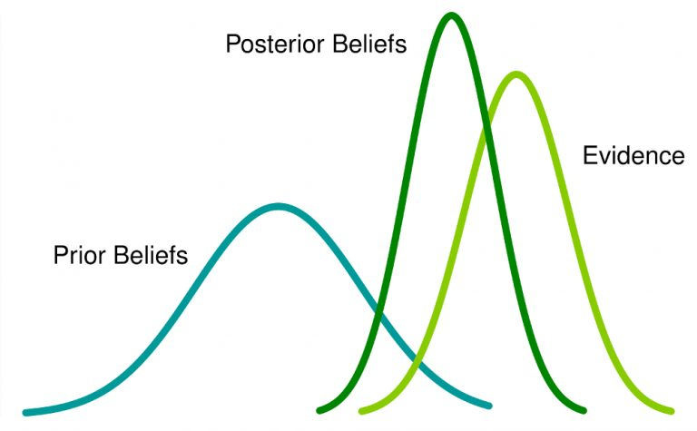

Slide 5
Frequentist Statistics tests whether an event (hypothesis) occurs or not. It calculates the probability of an event in the long run of the experiment (i.e the experiment is repeated under the same conditions to obtain the outcome).

Slide 6
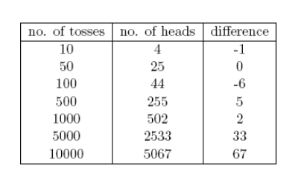

Slide 7
This experiment presents us with a very common flaw found in frequentist approach i.e. Dependence of the result of an experiment on the number of times the experiment is repeated.

Slide 8
p-values measured against a sample (fixed size) statistic with some stopping intention changes with change in intention and sample size. i.e If two persons work on the same data and have different stopping intention, they may get two different p- values for the same data, which is undesirable.

Slide 9
“Bayesian statistics is a mathematical procedure that applies probabilities to statistical problems. It provides people the tools to update their beliefs in the evidence of new data.”

Slide 10
conditional probability
Suppose, out of all the 4 championship races (F1) between Niki Lauda and James hunt, Niki won 3 times while James managed only 1.
So, if you were to bet on the winner of next race, who would he be ?
I bet you would say Niki Lauda.
Here’s the twist. What if you are told that it rained once when James won and once when Niki won and it is definite that it will rain on the next date. So, who would you bet your money on now ?
By intuition, it is easy to see that chances of winning for James have increased drastically. But the question is: how much ?

Slide 11
Linear Algebra
Probability and Basic Statistics

Slide 12
Suppose, B be the event of winning of James Hunt. A be the event of raining. Therefore,
P(A) =1/2, since it rained twice out of four days.
P(B) is 1/4, since James won only one race out of four.
P(A|B)=1, since it rained every time when James won.
Substituting the values in the conditional probability formula, we get the probability to be around 50%, which is almost the double of 25% when rain was not taken into account (Solve it at your end).
This further strengthened our belief of James winning in the light of new evidence i.e rain. You must be wondering that this formula bears close resemblance to something you might have heard a lot about. Think!
Probably, you guessed it right. It looks like Bayes Theorem.

Slide 13
Models are the mathematical formulation of the observed events.
Parameters are the factors in the models affecting the observed data.

Slide 14
Prior – before experiment
Posterior – After experiment/evidence
To define our model correctly , we need two mathematical models before hand. One to represent the likelihood function P(D|θ) and the other for representing the distribution of prior beliefs . The product of these two gives the posterior belief P(θ|D) distribution.

Slide 15
Bernoulli likelihood function
no previous experience – No prior belief - uninformative priors

Slide 16
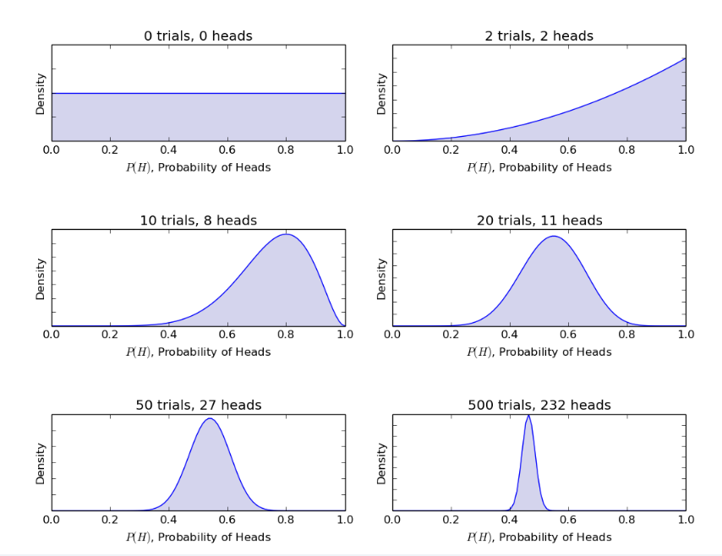

Slide 17
R Code
library(stats)
par(mfrow=c(3,2))
x=seq(0,1,by=0.1)
alpha=c(0,2,10,20,50,500)
beta=c(0,2,8,11,27,232)
for(i in 1:length(alpha)){
y<-dbeta(x,shape1=alpha[i],shape2=beta[i])
plot(x,y,type="l")
}

Slide 18
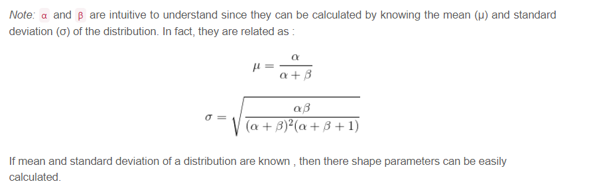

Slide 19
Bayes factor is defined as the ratio of the posterior odds to the prior odds,
immediate benefits of using Bayes Factor instead of p-values since they are independent of intentions and sample size.

Slide 20
Specifying a Prior for a Proportion
For example, if you want to estimate the proportion of people like chocolate, you might have a rough idea that the most likely value is around 0.85, but that the proportion is unlikely to be smaller than 0.60 or bigger than 0.95.

Slide 21
quantile1 <- list(p=0.5, x=0.85) # we believe the median of the prior is 0.85
quantile2 <- list(p=0.99999,x=0.95) # we believe the 99.999th percentile of the prior is 0.95
quantile3 <- list(p=0.00001,x=0.60) # we believe the 0.001st percentile of the prior is 0.60

Slide 22
curve(dbeta(x,52.22,9.52105105105105)) # plot the prior
Posterior Distribution
Bayesian learning has the Automatic Relevance Determination (ARD) capability built-in for this purpose

Slide 23
vbmp.
MCMC
Not a category model

Slide 24
Specifying a Prior for a Proportion
Calculating the Likelihood Function for a Proportion
Calculating the Posterior Distribution for a Proportion

Slide 25
Bayesian inference
MCMC – Metropoilis algo
library(mcmc)
data(logit)
out <- glm(y ~ x1 + x2 + x3 + x4, data = logit,
family = binomial(), x = TRUE)
summary(out)

Slide 26
library(LaplacesDemon)
# The model specification
model <- function(parm, data) {
mu <- parm[1]
sigma <- exp(parm[2])
log_lik <- sum(dnorm(data$y, mu, sigma, log = T))
post_lik <- log_lik + dnorm(mu, 0, 100, log = T) + dlnorm(sigma, 0, 4, log = T)
# This list is returned and has to follow a the format specified by
# LaplacesDemon.
list(LP = post_lik, Dev = -2 * log_lik, Monitor = c(post_lik, sigma), yhat = NA,
parm = parm)
}
# Running the model
data_list <- list(N = length(y), y = y, mon.names = c("post_lik", "sigma"), parm.names = c("mu", "log.sigma"))
print(data_list)
mcmc_samples <- LaplacesDemon(Model = model, Data = data_list, Iterations = 30000, Algorithm = "HARM", Thinning = 1)
print(mcmc_samples)
plot(mcmc_samples, BurnIn = 10000, data_list)

Slide 27
Naïve Bayes – recommendation system, classification
Apriori - Mining associated rules.

Slide 28
naivebayes
data(iris)
print(data)
library("naivebayes")
nb <- naive_bayes(Species ~ ., data = iris)
plot(nb)
print(nb)

Slide 29
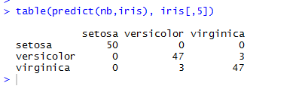
table(predict(nb,iris), iris[,5])

Slide 30
Laplace estimation, smoothing
Naivebayes classifier
Normal or Gaussian distribution
Discrete and Continuous variable
Bayesian SPAM filter

